Slide 1
Incrementing and Decrementing
9/15/09 - L15 Decoders, Multiplexers
Copyright 2009 - Joanne DeGroat, ECE, OSU

Slide 2
Class 18a – Special arithmetic circ.
Incrementers
Decrementers
Circuits
Material from section 4-5of text
9/15/09 - L15 Decoders, Multiplexers
Copyright 2009 - Joanne DeGroat, ECE, OSU

Slide 3
Incrementer
Often just want to increment the value by 1 and that is the only operation needed.
An incrementer is a circuit that is much simpler than an adder.
Start with the equations:
  SUM = A xor B xor C_{in}
  C_{out} = AB + AC_{in} + BC_{in}
9/15/09 - L15 Decoders, Multiplexers
Copyright 2009 - Joanne DeGroat, ECE, OSU

Slide 4
Incrementer
Often we just want a circuit to create the value +1 each time.
The circuit is a significant simplification.
Start with the equations for general addition
  Sum = A ⊕ B ⊕ C_{in}
  C_{out} = AB + BC_{in} + AC_{in}
Now if B = 0 these reduce to
  IncSum = A ⊕ C_{in}
  Inc Carry= A0 + B0 + AC_{in} = AC_{in}
A Half Adder!!!
9/15/09 - L15 Decoders, Multiplexers
Copyright 2009 - Joanne DeGroat, ECE, OSU

Slide 5
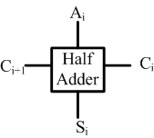
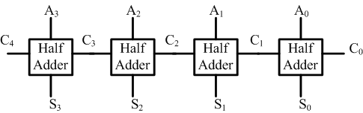
Implementation
A increment unit
Note that hardware can be simplified if you have a unit that always increments.
9/15/09 - L15 Decoders, Multiplexers
Copyright 2009 - Joanne DeGroat, ECE, OSU

Slide 6
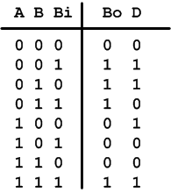
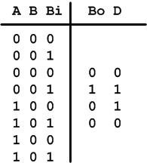
A Decrementer
Want to subtract 1 from the input.
reduces to
What are the equations
  Difference D=A⊕B⊕Bor_{in} reduces to A⊕Bor_{in}
  Borrow-out B_{out}= BBor_{in} + A’B+A’Bor_{in}
  Reduces to B_{out} = A’Bor_{in}
9/15/09 - L15 Decoders, Multiplexers
Copyright 2009 - Joanne DeGroat, ECE, OSU

Slide 7
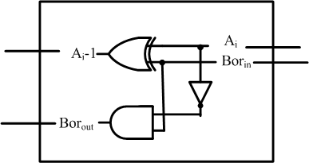
The circuit
And again can do a dedicated circuit
And again can do a multiple bit implementation with simplification of the lsb and msb.
9/15/09 - L15 Decoders, Multiplexers
Copyright 2009 - Joanne DeGroat, ECE, OSU

Slide 8
Class 18a assignment
Covered sections 4-5
Problems for hand in
  none
Problems for practice
  none
Reading for next class: sections 5-1, 5-2
9/15/09 - L15 Decoders, Multiplexers
Copyright 2009 - Joanne DeGroat, ECE, OSU

